Slide 1
When Computer Science Meets Social Science -- User Stance Prediction via Information Network Mining
Yizhou Sun
Department of Computer Science
University of California, Los Angeles
yzsun@cs.ucla.edu
September 27, 2018

Slide 2
Outline
Introduction
Ideology Detection via Legislative Voting Network Mining
Ideology Detection via Heterogeneous Types of Links
User Stance Prediction via Joint Modeling of Text and Social Interactions
The Co-Evolution Model for Social Network Evolving and Opinion Migration
Summary

Slide 3
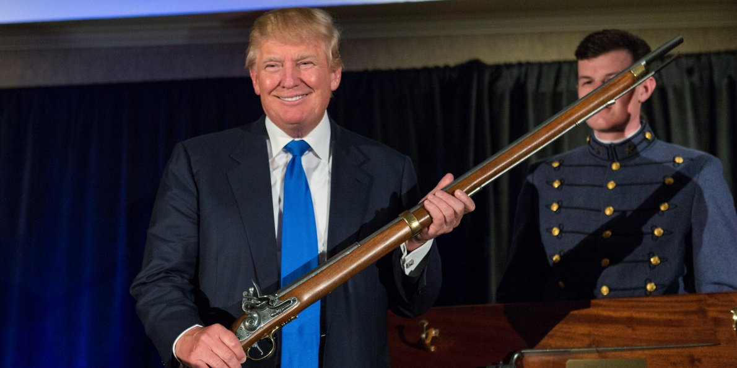
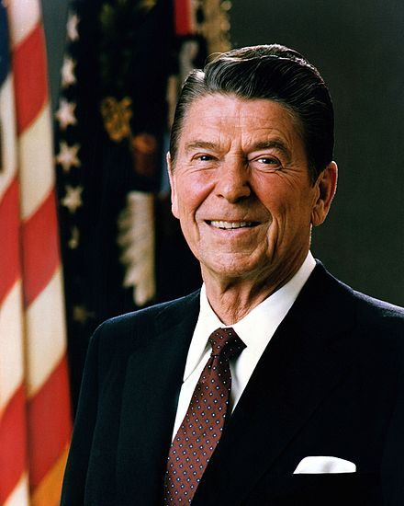
Motivating Examples
What is the stance of Trump in the issue of military service?
Whether a bill will be passed in congress?
What is the average ideology of Twitter users in each state?
By reading a news comment, can you infer the user’s stance on that issue?
Will a person’s ideology migrate, and can you predict that?

Slide 4
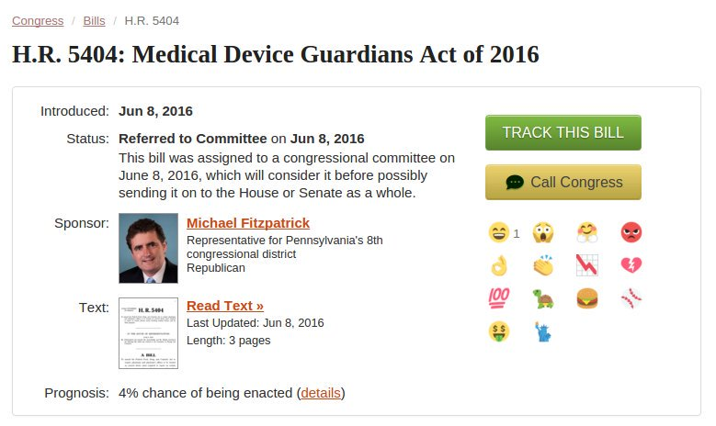
GovTrack.us
Notes:
Different Behaviors are Captured Online

Slide 5
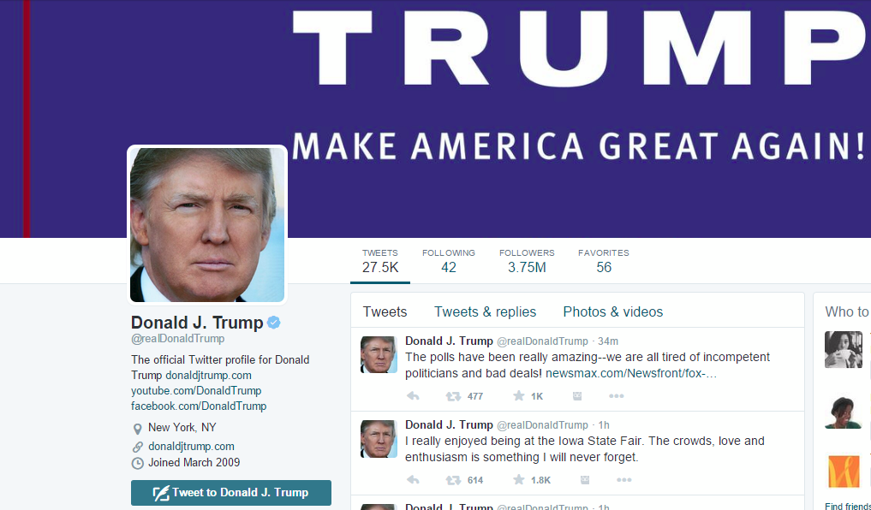
Twitter

Slide 6
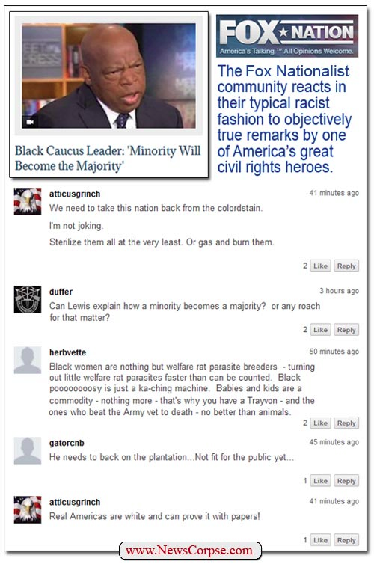
News Comments

Slide 7
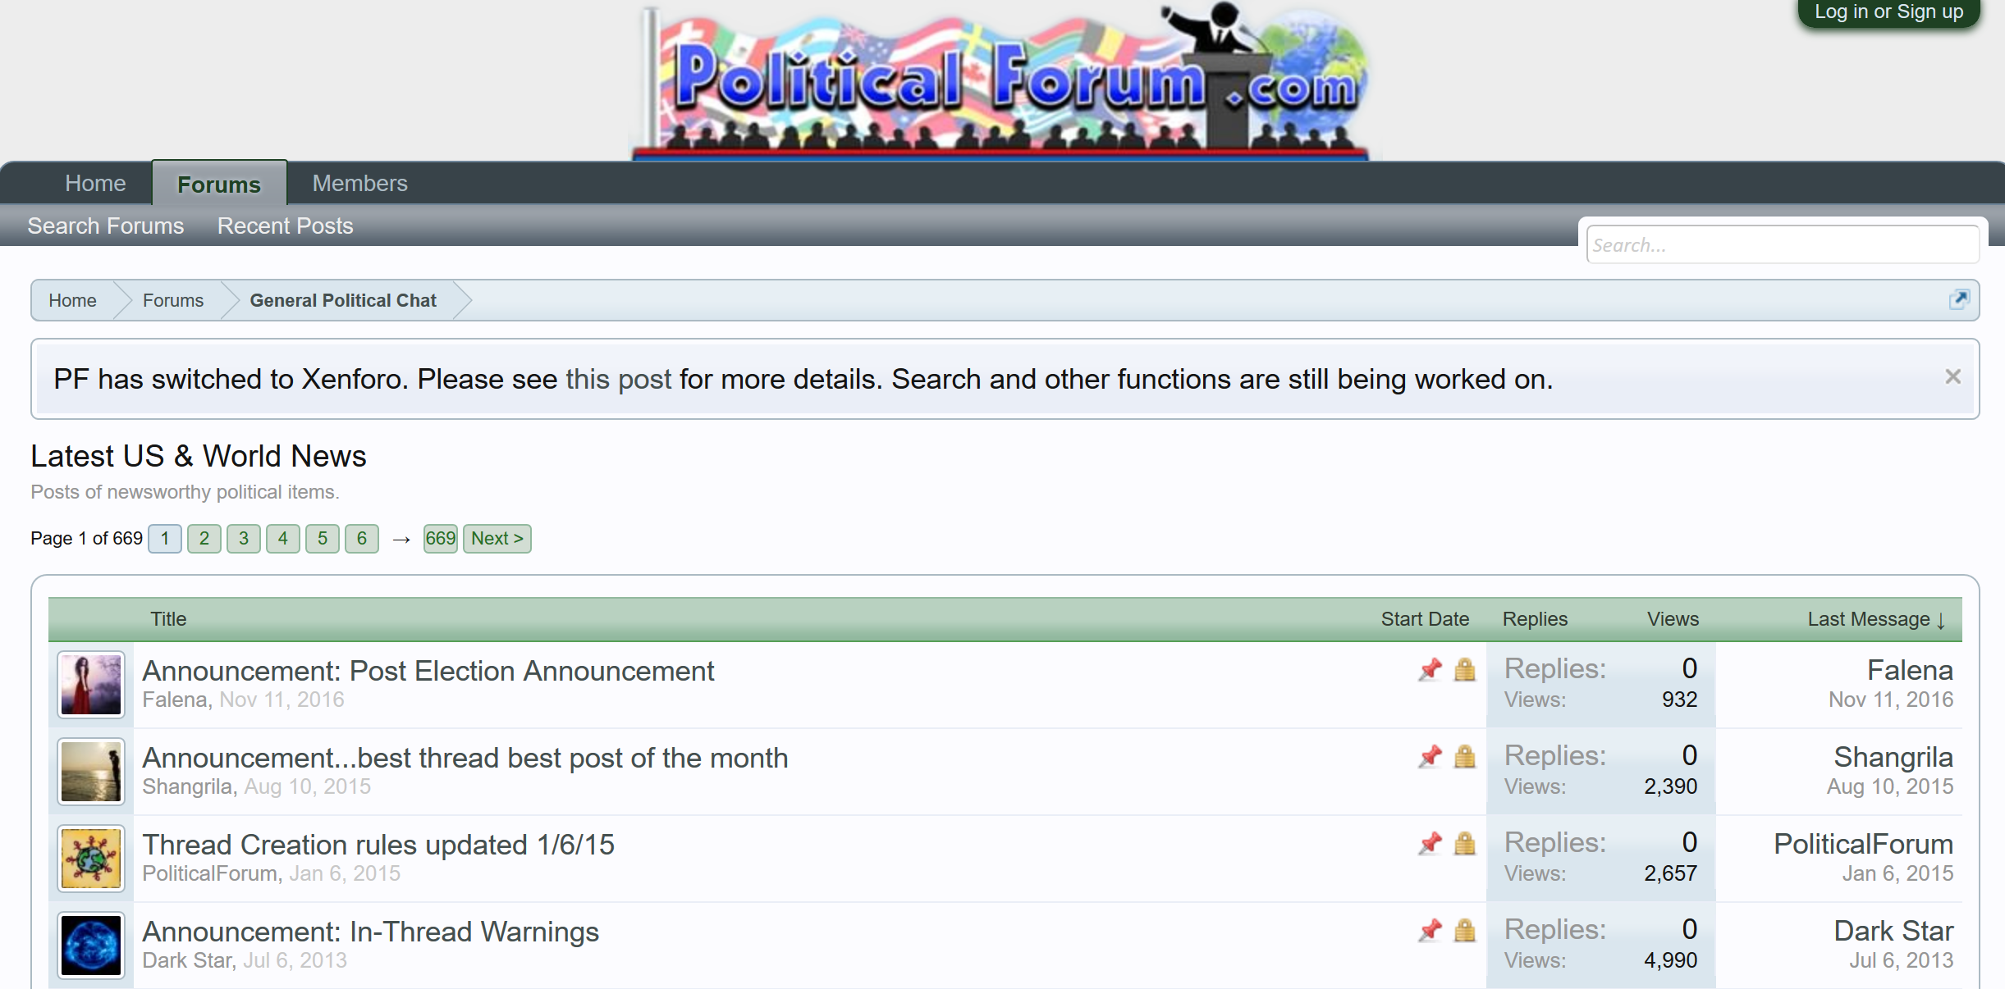
Online Forums

Slide 8
Outline
Introduction
Ideology Detection via Legislative Voting Network Mining
Ideology Detection via Heterogeneous Types of Links
User Stance Prediction via Joint Modeling of Text and Social Interactions
The Co-Evolution Model for Social Network Evolving and Opinion Migration
Summary

Slide 9
Topic-Factorized Ideal Point Estimation Model for Legislative Voting Network (Gu et al., KDD’14)

Slide 10


Background of Congress Roll Call Data
Federal Legislation
(bill)
The House
Senate
Law
Bill 1
Bill 2
……
Ronald Paul
Barack Obama
……
Notes:
US Congress: is the bicameral legislature of the federal government of the United States consisting of two houses

Slide 11
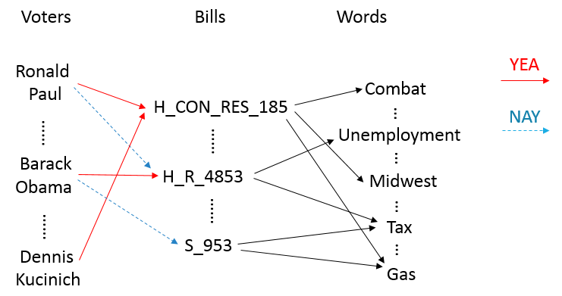
Legislative Voting Network
Notes:
Solid lines (support) & dashed lines (oppo’sition)
Point out this is a heterogeneous network

Slide 12
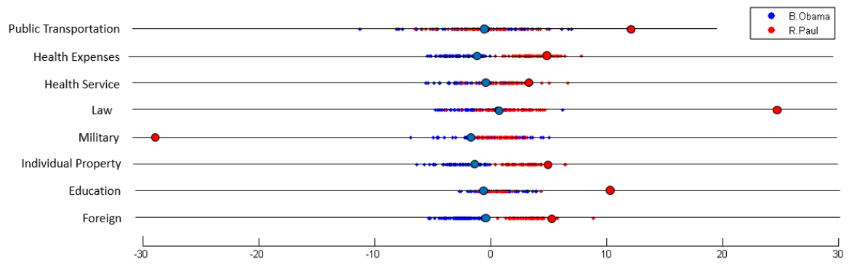
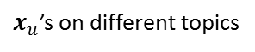
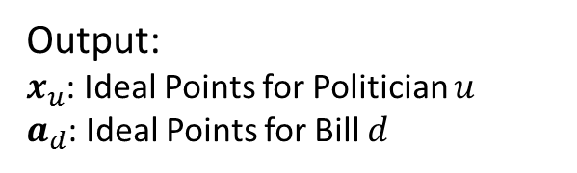
Problem Definition
Output:
$x_{u}$: Ideal Points for Politician $u$
$a_{d}$: Ideal Points for Bill $d$
Input:
Legislative Network
$x_{u}$’s on different topics
Notes:
Our goal: predict R/D, how liberal she is
It’s extremely helpful to predict the party affiliation for a politician, to know her attitude towards different topics, and her placement among all politicians

Slide 13
Existing Work
1-dimensional ideal point model (Poole and Rosenthal, 1985; Gerrish and Blei, 2011)
High-dimensional ideal point model (Poole and Rosenthal, 1997)
Issue-adjusted ideal point model (Gerrish and Blei, 2012)
Notes:
(3) First train a global ideal point like 1. When talked about different topics, they make adjustments based on the global ideal point. They train topic distribution on the text part, and use it as a guidance of the adjustment for each topic.

Slide 14

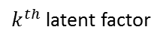
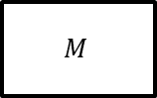
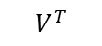
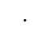
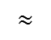
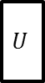
Motivation
Voters have different positions on different topics.
Topic 1
Topic 2
Topic 3
Topic 4
Traditional matrix factorization method cannot give the meanings for each dimension.
$$M$$
$$U$$
$$V^{T}$$
$$≈$$
$$⋅$$
$k^{th}$ latent factor
Topics of bills can influence politician’s voting, and the voting behavior can better guide the topics of bills as well.
Topic Model:
Health
Public Transport
…
Voting-guided Topic Model:
Health Service
Health Expenses
Public Transport
…
Notes:
1, we need to find ideal points on multiple topics
2, how can we achieve this? → combine two parts
3, … that is, which topics do they concern when they vote → formulation of our model

Slide 15
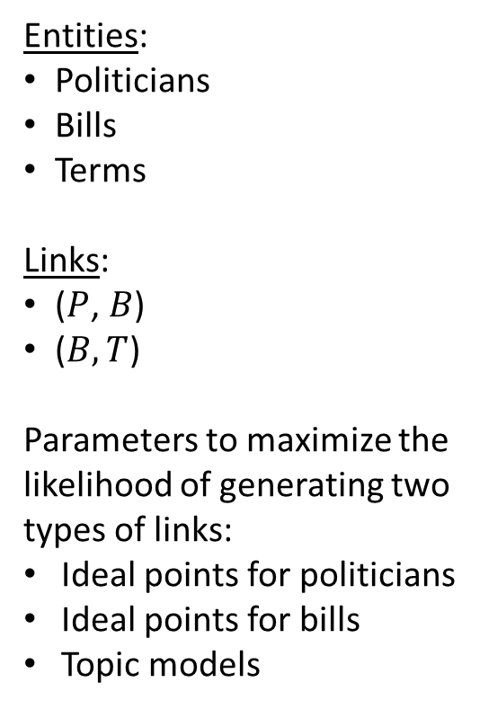

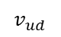
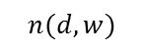


Topic-Factorized IPM
Entities:
Politicians
Bills
Terms
Links:
($P$, $B$)
($B, T$)
Parameters to maximize the likelihood of generating two types of links:
Ideal points for politicians
Ideal points for bills
Topic models
$$n(d,w)$$
$$w$$
$$v_{ud}$$
$$u$$
$$d$$
Politicians
Bills
Terms
Heterogeneous Voting Network
Notes:
Study the two different types of links

Slide 16
Text Part
$$n(d,w)$$
$$w$$
$$v_{ud}$$
$$u$$
$$d$$
Politicians
Bills
Terms

Slide 17
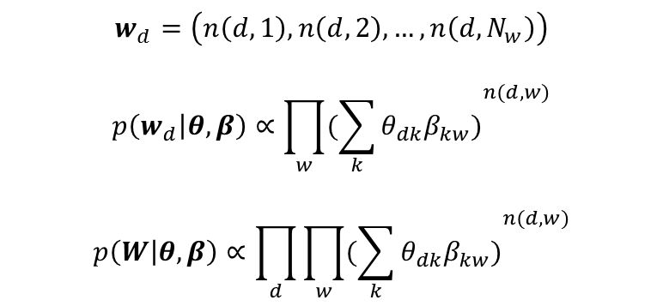
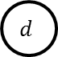
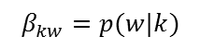
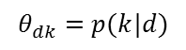
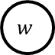
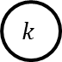
Text Part
We model the probability of each word in each document as a mixture of categorical distributions, as in PLSA (Hofmann, 1999) and LDA (Blei et al., 2003)
$$θ_{dk}=p(k|d)$$
$$β_{kw}=p(w|k)$$
$$d$$
$$k$$
$$w$$
Bill
Topic
Word
$$w_{d}=\left(n\left(d,1\right),n\left(d,2\right),…,n\left(d,N_{w}\right)\right)$$
$$p\left(w_{d} | θ,β\right)∝{\prod_{w}{(\sum_{k}{θ_{dk}β_{kw})}}}^{n(d,w)}$$
$$p\left(W | θ,β\right)∝\prod_{d}{\prod_{w}{({\sum_{k}{θ_{dk}β_{kw})}}^{n(d,w)}}}$$
Notes:
\theta: the probability of bill d belonging to topic k
\beta: the probability that topic k generates word w

Slide 18
Voting Part
Intuitions:
The more similar of the ideal points of u and d, the higher probability of “YEA” link
The higher portion a bill belongs to topic k, the higher weight of ideal points on topic k
$$n(d,w)$$
$$w$$
$$v_{ud}$$
$$u$$
$$d$$
Politicians
Bills
Terms

Slide 19
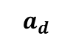
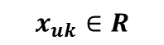
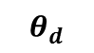
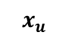
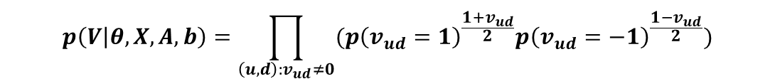
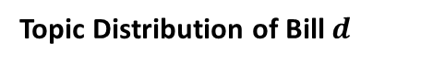
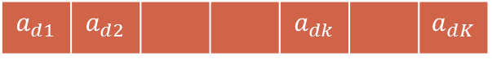
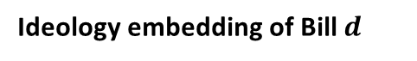
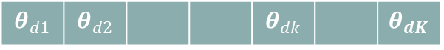
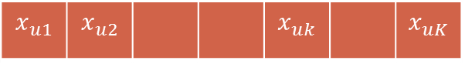
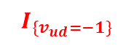
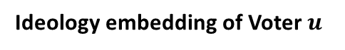
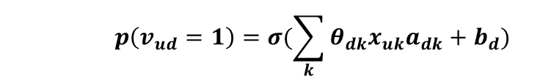
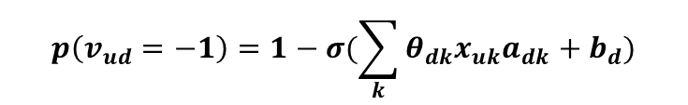
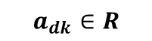
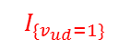
Voting Part
Ideology embedding of Voter $u$
$$x_{u}$$
$$x_{u1}$$ | $$x_{u2}$$ |  |  | $$x_{uk}$$ |  | $$x_{uK}$$
$$x_{uk}∈R$$
$$a_{d}$$
$$a_{d1}$$ | $$a_{d2}$$ |  |  | $$a_{dk}$$ |  | $$a_{dK}$$
Ideology embedding of Bill $d$
$$a_{dk}∈R$$
Topic Distribution of Bill $d$
$$θ_{d}$$
$$θ_{d1}$$ | $$θ_{d2}$$ |  |  | $$θ_{dk}$$ |  | $$θ_{dK}$$
$$p\left(v_{ud}=1\right)=σ(\sum_{k}{θ_{dk}x_{uk}a_{dk}}+b_{d})$$
YEA
Grounded in social choice theory: Choose YEA or NAY?
$$p\left(v_{ud}=−1\right)=1−σ(\sum_{k}{θ_{dk}x_{uk}a_{dk}}+b_{d})$$
NAY
$$I_{\{v_{ud}=1\}}$$
$$I_{\{v_{ud}=−1\}}$$
$$p\left(V | θ,X,A,b\right)=\prod_{\left(u,d\right):v_{ud}≠0}{(p{\left(v_{ud}=1\right)}^{\frac{1+v_{ud}}{2}}p{\left(v_{ud}=−1\right)}^{\frac{1−v_{ud}}{2}}})$$
Notes:
In the settings of MF, low-dimension vectors x and a are learned for each user and bill respectively, to approximate the original voting matrix.
$b_{d}$: offset/bias (it is reasonable because some bills really have more supports than others)
$θ$: (“how can we utilize topic information?”)

Slide 20
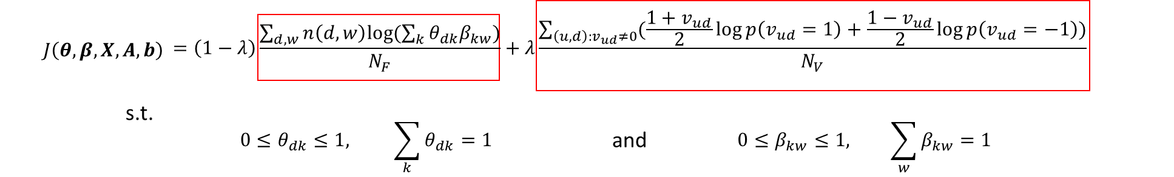
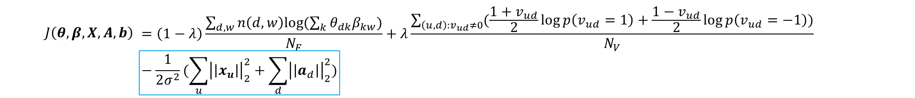
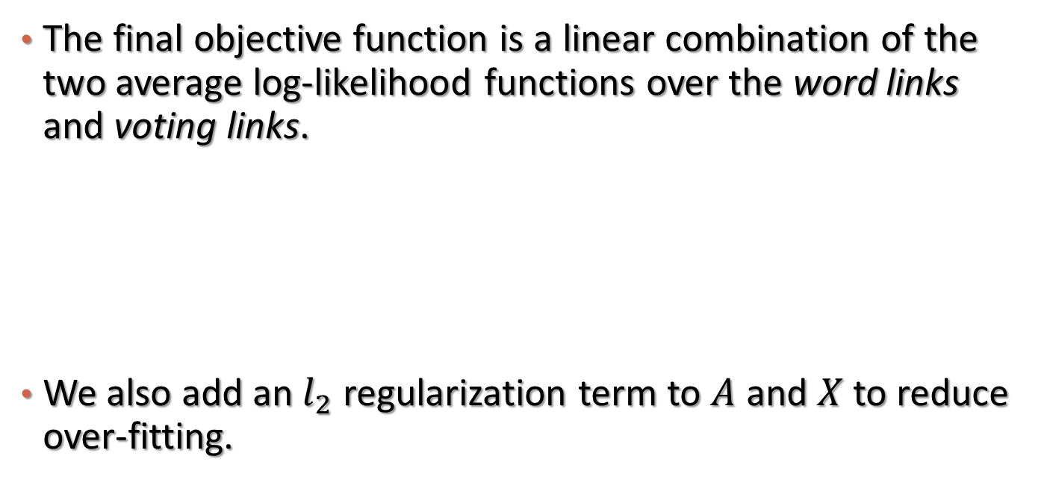
Combining Two Parts Together
The final objective function is a linear combination of the two average log-likelihood functions over the word links and voting links.
We also add an $l_{2}$ regularization term to $A$ and $X$ to reduce over-fitting.

Slide 21
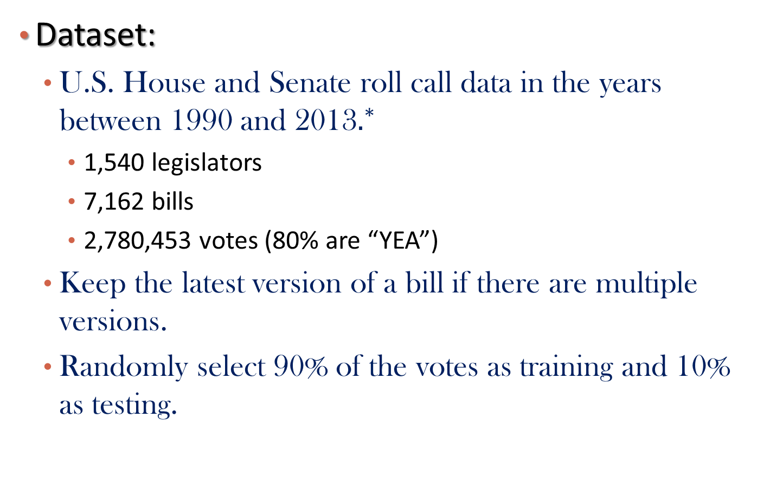
Data Description
Dataset:
U.S. House and Senate roll call data in the years between 1990 and 2013$.^{∗}$
1,540 legislators
7,162 bills
2,780,453 votes (80% are “YEA”)
Keep the latest version of a bill if there are multiple versions.
Randomly select 90% of the votes as training and 10% as testing.
${}^{∗}$ Downloaded from http://thomas.loc.gov/home/rollcallvotes.html

Slide 22
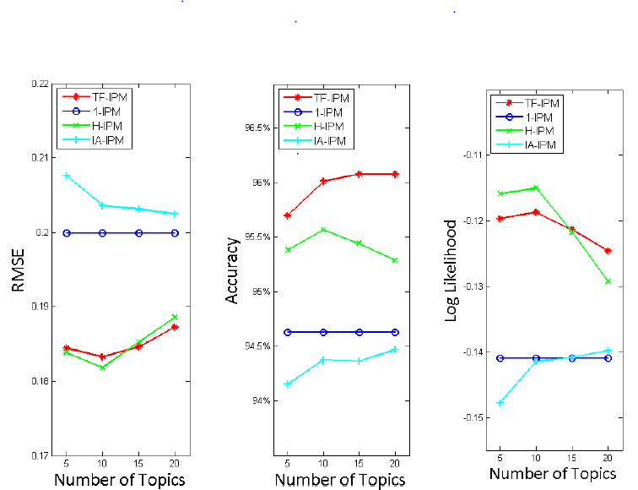
Experimental Results: Voting Result Prediction
Notes:
Show our advantages over (1)1-ipm; (2)H-IPM; (3)IA-IPM

Slide 23
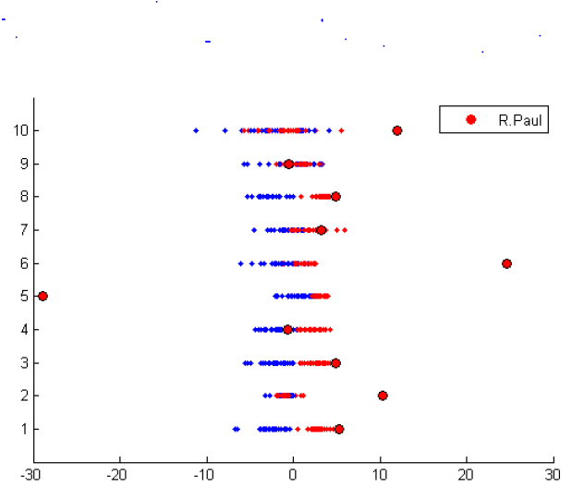
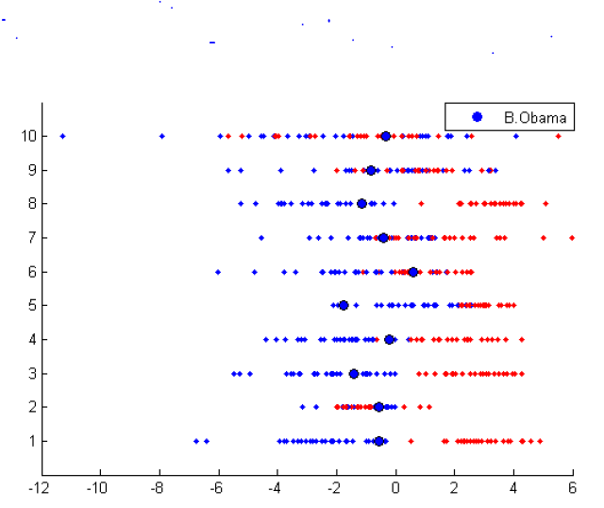
Case Studies
Ronald Paul (R), Barack Obama (D)
Public Transportation
Funds
Health Expenses
Health Service
Law
Military
Financial Institution
Individual Property
Education
Foreign
Notes:
Republican: conservative Democrat: liberal
Liberal at war = anti-war

Slide 24
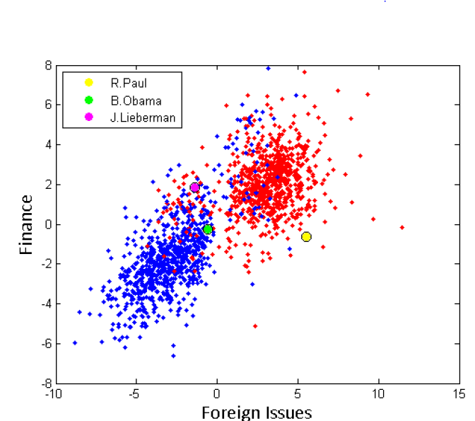
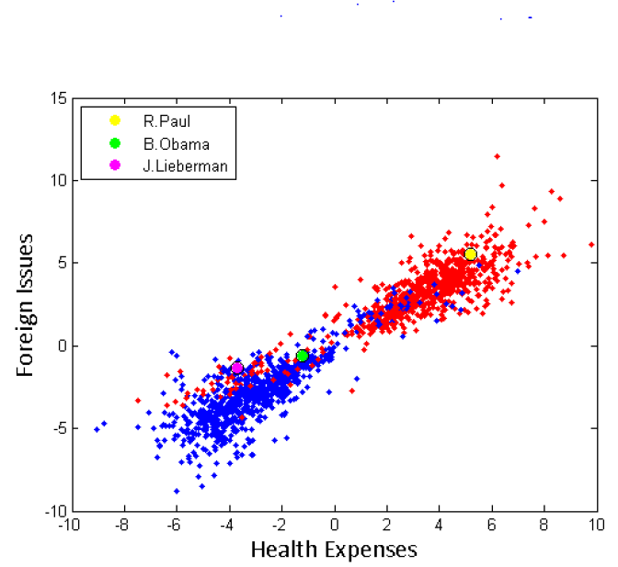
Case Studies
Scatter plots over selected dimensions: (Republican, Democrat)
Notes:
We can also detect outliers from such visualization (e.g. R.Paul is an outlier in the first fig)

Slide 25
Outline
Introduction
Ideology Detection via Legislative Voting Network Mining
Ideology Detection via Heterogeneous Types of Links
User Stance Prediction via Joint Modeling of Text and Social Interactions
The Co-Evolution Model for Social Network Evolving and Opinion Migration
Summary

Slide 26

Ideology Detection for Twitter Users [Gu et al., SBP-BRiMS 2017]

Slide 27
Challenges
How to model behavior links using ideology?
A link generative model with ideology as latent variable
Another social choice problem: to follow or not?
How to combine different types of behaviors?
Heterogeneous network mining

Slide 28
Ideology Detection via Single Type of Links
Assumptions
People tend to follow, mention, or retweet others who share similar ideology score
One’s true ideology score is different from one’s public image ideology score

Slide 29

Model: Take Follow Link Type as an Example
Consider a follow link: $i→j$
$p_{i}$: true ideology of user i
$q_{j}$: image ideology of user j
$b_{j}$: bias term of user j, indicating the popularity of user j
The probability of the link:
$p\left(i→j\right)=σ(p_{i}^{′}q_{j}+b_{j})$ ($σ$ is the sigmoid function)
Connection to utility function:
The utility function of user i choose to follow j is higher than the one of user i choose to not follow j.

Slide 30
Objective Function
Maximize the likelihood of observed positive links and sample negative links

Slide 31

Ideology Detection via Multiple Types of Links
Consider a link of type r: $i\underset{→}{r}j$
$p_{i}$: true ideology of user i
$q_{j}^{(r)}$: image ideology of user j for link type r
$b_{j}^{(r)}$: bias term of user j for link type r, indicating the popularity of user j in link type r
The probability of the link:
$p\left(i\underset{→}{r}j\right)=σ(p_{i}^{′}q_{j}^{(r)}+b_{j}^{(r)})$ ($σ$ is the sigmoid function)

Slide 32

Objective Function
Maximize the weighted sum of the likelihood function for each link type
Importance of r_{th} link type
Constraints on $w_{r}$: $w_{r}>0 and \prod_{r}{w_{r}=1}$
Geometric mean =1

Slide 33
Data Collection
Step 1: Seed users collection
Manually collect 487 politicians from Twitter
Step 2: expand from seeds
5000 followers and followees for each seed
Step 3: filtering
User set I (heavily political related): users with more than 20 followers or followees in the seed set
User set II (less political related): users with 3-5 followers or followees in the seed set, random sample 10,000

Slide 34
Results on Ranking and Classification

Slide 35
Retweet Link Prediction
Using ideology to predict retweet link

Slide 36

Case Study 1
The ideology map of U.S.

Slide 37

Case Study 2
Ideology for selected accounts

Slide 38


Ideology of Presidential Candidates

Slide 39
Outline
Introduction
Ideology Detection via Legislative Voting Network Mining
Ideology Detection via Heterogeneous Types of Links
User Stance Prediction via Joint Modeling of Text and Social Interactions
The Co-Evolution Model for Social Network Evolving and Opinion Migration
Summary

Slide 40

Weakly-Guided User Stance Prediction via Joint Modeling of Content and Social Interaction (Dong et al., CIKM’17)

Slide 41
Intuitions to the Solution
With different stances, words are used differently even for the same issue
E.g., “same-sex marriage” vs. “gay marriage”
User interaction will contribute to the learn the right contrasting view points for each issue
E.g., a reply indicating “disagree” implies the opposite signs of the related two users

Slide 42
Case Study from CNN News Comments

Slide 43
Outline
Introduction
Ideology Detection via Legislative Voting Network Mining
Ideology Detection via Heterogeneous Types of Links
User Stance Prediction via Joint Modeling of Text and Social Interactions
The Co-Evolution Model for Social Network Evolving and Opinion Migration
Summary

Slide 44
The Co-Evolution Model for Social Network Evolving and Opinion Migration (Gu et al., KDD’17)

Slide 45
Network Generation
People with similar ideology tends to link together
How to define similarity?
Dot product-based similarity
Euclidean distance-based similarity

Slide 46

Gravity-based Score Function
Observations
Opinion leader have more connections
Model opinion leaders explicitly: $b_{i} for actor i$
Opinion leaders tend to have a non-extreme ideology
Choose Euclidean distance-based score
The score function: extending Gaussian Kernel
Link Generation:
$G_{ij}=1, if p_{ij}>d$, where $d$ is the system parameter controlling how easy to form a link

Slide 47

Opinion Migration
Actors are influenced by their neighbors
What are influenced?
Position or moving direction?

Slide 48

Opinion Propagation Model
Moving directions determine the position
Continuous form:
Discrete from:
Moving directions are influence by social neighbors
$$σ^{2}:system level parameter$$
$$controling the noise$$

Slide 49

Putting it together
The co-evolution model
moving
direction
ideology
network

Slide 50


Simulation
System level parameters:
Actor popularity: b
Network sparsity: d
Noise in propagation: $σ^{2}$

Slide 51
Discovery
System level parameters can control the behavior of evolution

Slide 52
Small noise, fewer friends
Communities appear, opinion divergence

Slide 53
Small noise, more friends
Opinion convergence

Slide 54
Big noise
Random

Slide 55
Intervention
How to alleviate opinion divergence?
Increase number of friends (diversity)
Strong opinion leaders

Slide 56
Application
Dataset: Co-sponsorship between legislators, extracted from congress voting record
https://www.govtrack.us

Slide 57
Application 1: Identify Opinion Leaders
Learning popularity score: b
68th U.S. Secretary of State
45th U.S. Vice President
the majority leader of
the Senate since 2015

Slide 58
Application 2: Predicting Co-Sponsorship
Learning system-level parameters, and then run simulation

Slide 59
Outline
Introduction
Ideology Detection via Legislative Voting Network Mining
Ideology Detection via Heterogeneous Types of Links
User Stance Prediction via Joint Modeling of Text and Social Interactions
The Co-Evolution Model for Social Network Evolving and Opinion Migration
Summary

Slide 60
Summary
Online behaviors are ubiquitous
Content
Interaction with other entities
Dynamic
User stance prediction solution
Content rich information network mining
Three case studies in this line
Issue-based ideology detection for congress people
Ideology detection for twitter users via heterogeneous network mining
The co-evolution model that can explain and predict the dynamics

Slide 61
Q & A
Thank you!

